Slide 1
CAR INFORMATION MANAGEMENT SYSYTEM
Sri Bindu .G
ID:46008229
Mentor : Amol Patel

Slide 2

Objectives
Project Details
Case Diagram
Class Diagram
Sequence Diagram
Screenshots
Future Enhancements

Slide 3
Project Details
Car Information Management System(CIMS) is an application, which develops a user interface for managing Car Details.
It renders customers to search cars by Manufacturer Name, Type and Model.
Administrator can add , modify, delete the car details. They can also see Car details.
CIMS keeps track of customers and cars.
This application also provides search feature for both administrator and customers.
Car Information Management System (CIMS) helps Customers view the complete information about a given company’s car like Features, Engine & Performance etc.

Slide 4


Case Diagram
Add
Update
Administrator
Model
Delete
Manufacturer & Type
Search
Customer
Model
Customer
Get List

Slide 5
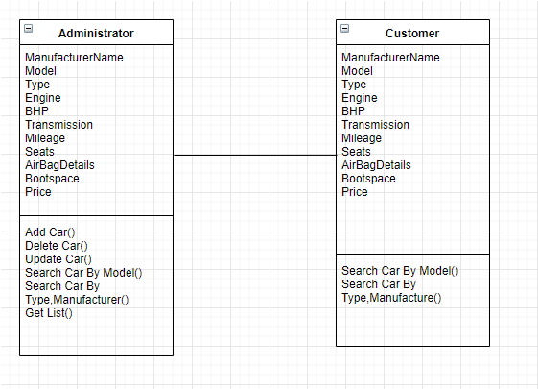
Class Diagram

Slide 6
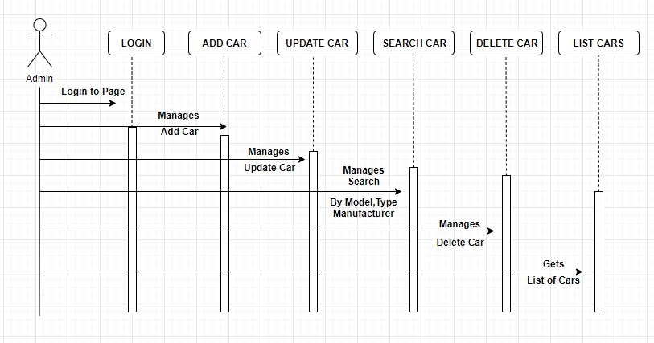
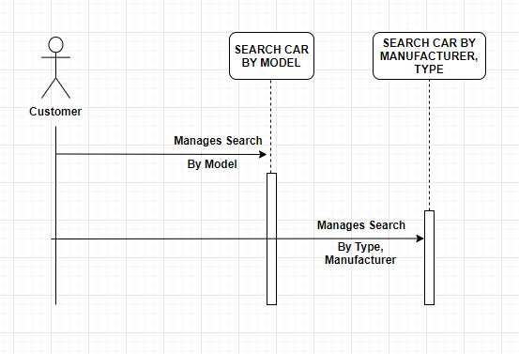
Sequence/Activity Diagram

Slide 7
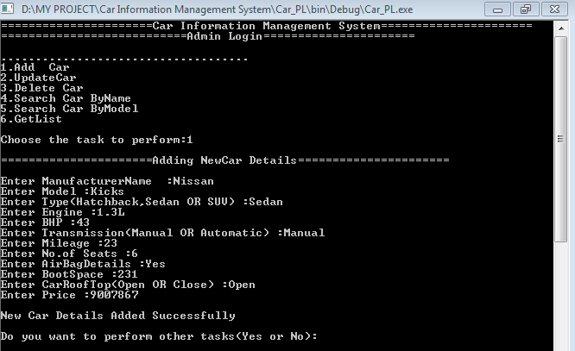
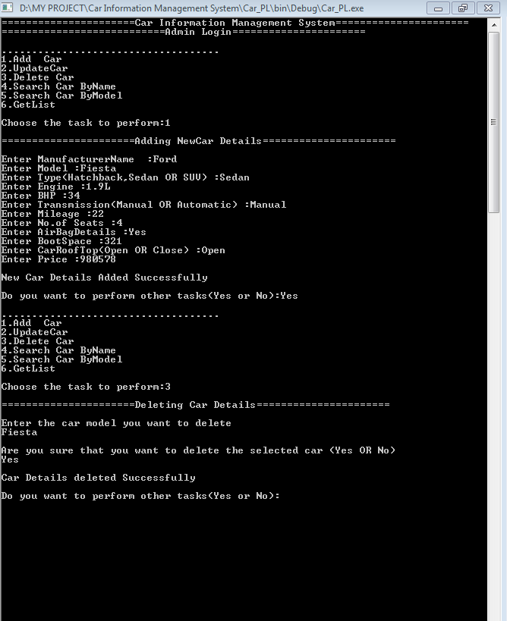
Screenshots-Phase1
Add car
Delete Car

Slide 8
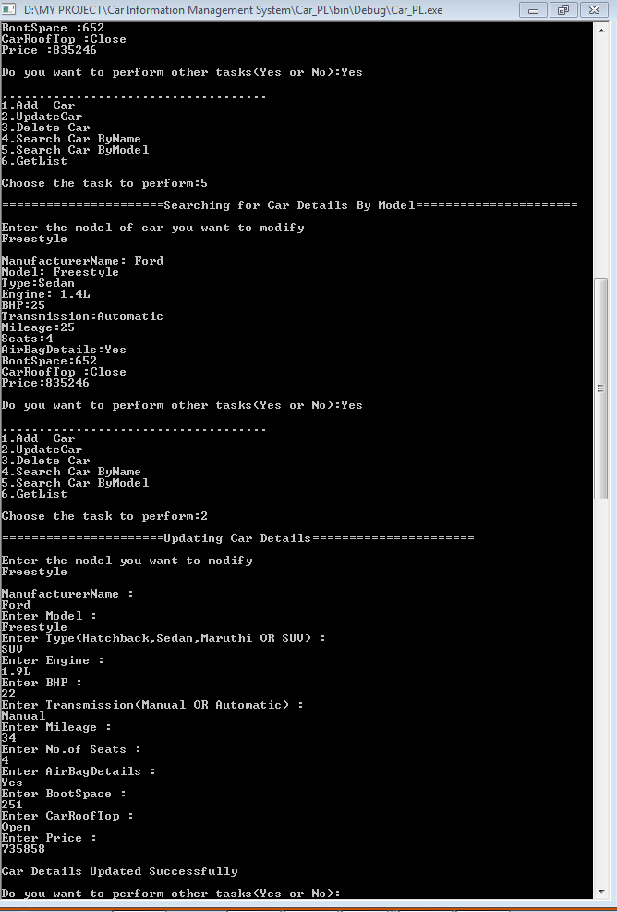
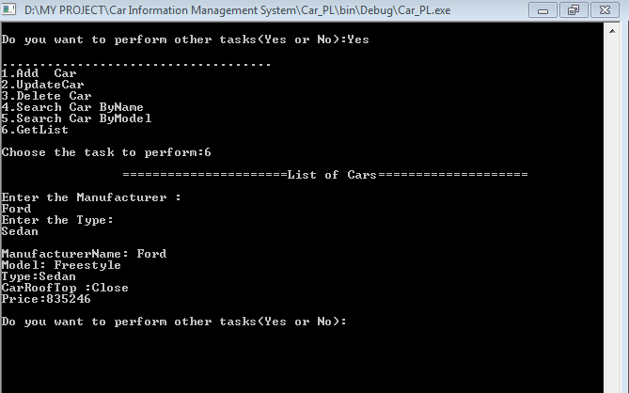
Update Car
List Car

Slide 9
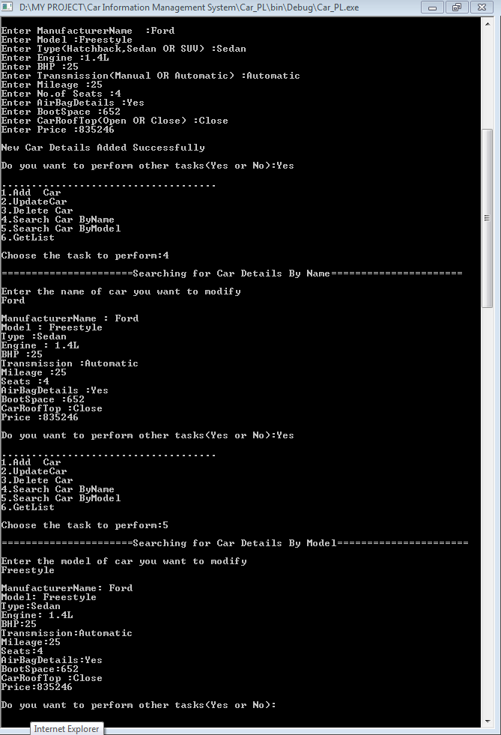
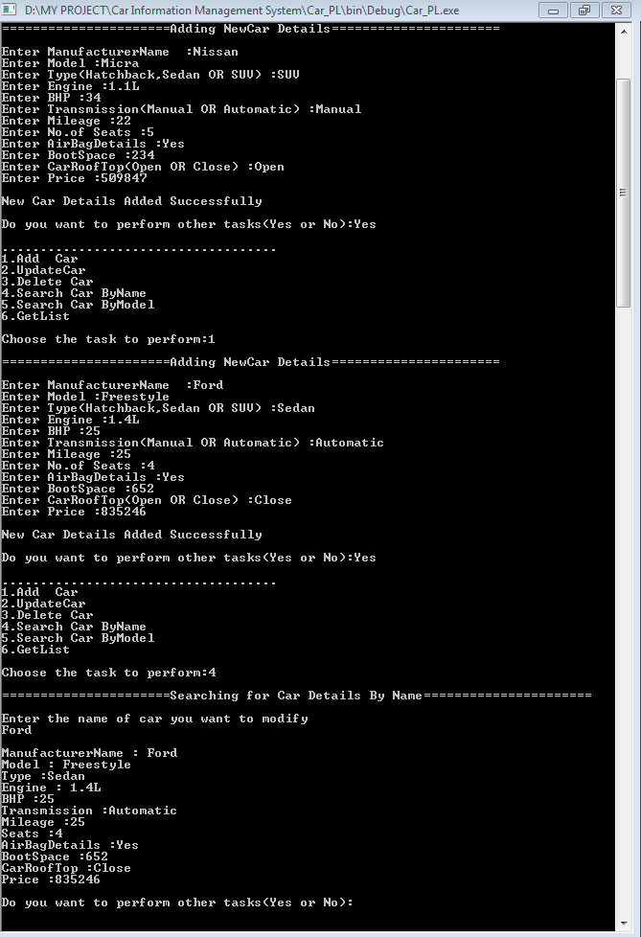
Search Car By Model
Search Car By Manufacturer & Type

Slide 10
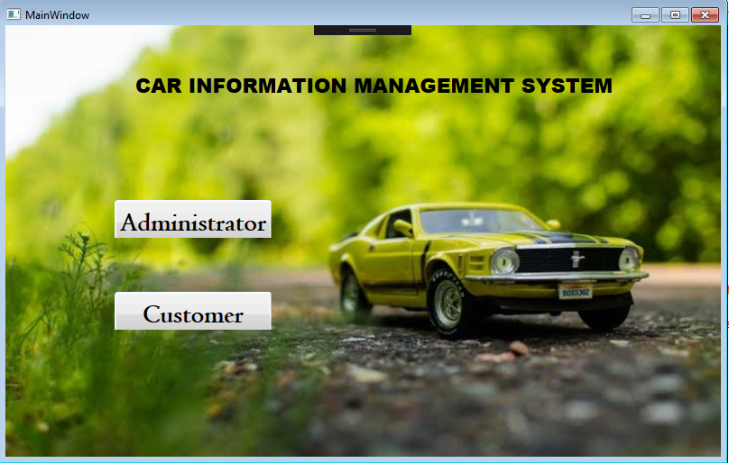
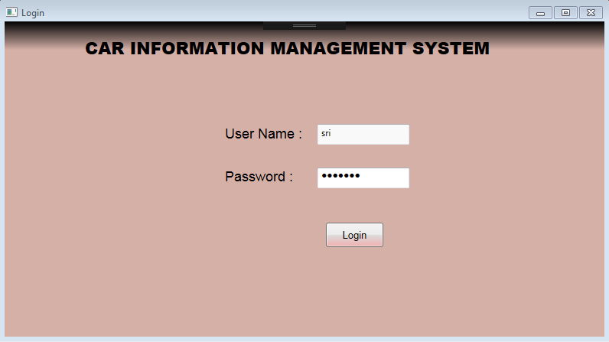
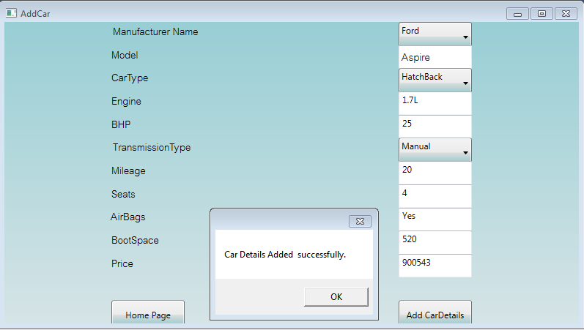
Screenshots-Phase 2
Main Window
Login Page
Add Car

Slide 11
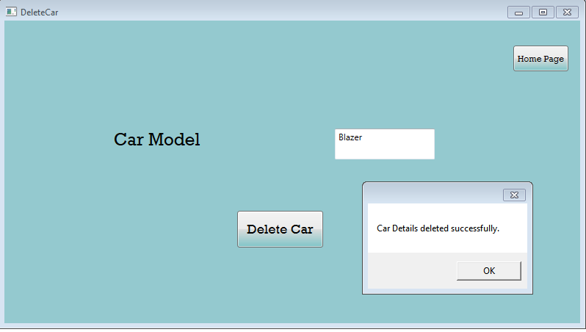
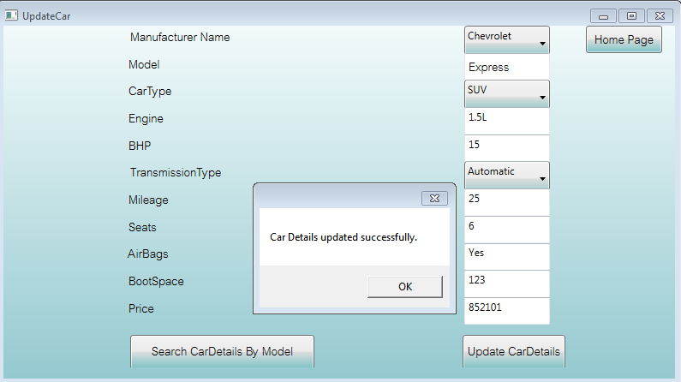
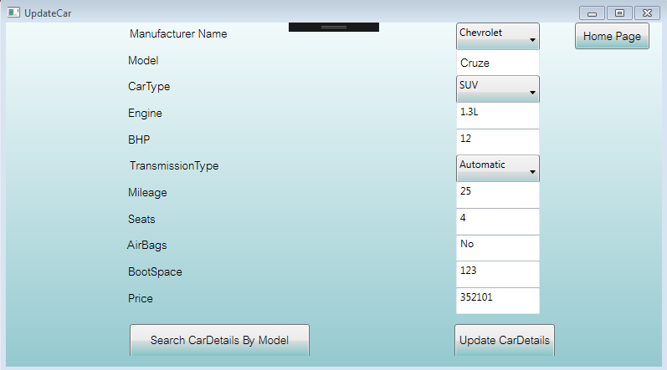
Delete Car
Update Car
Update Car Based on Model

Slide 12
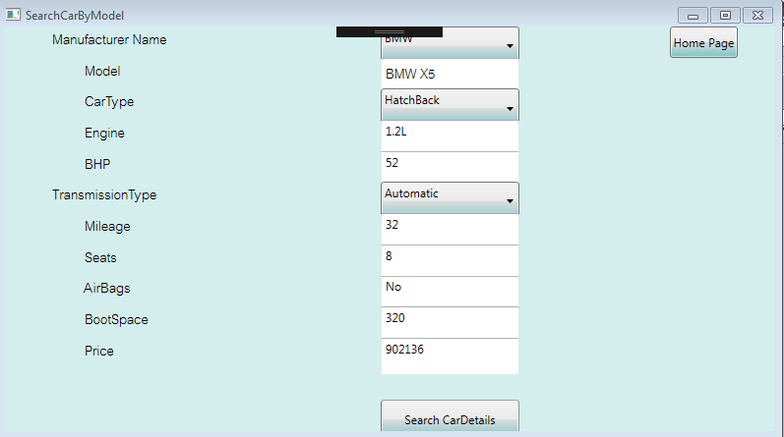
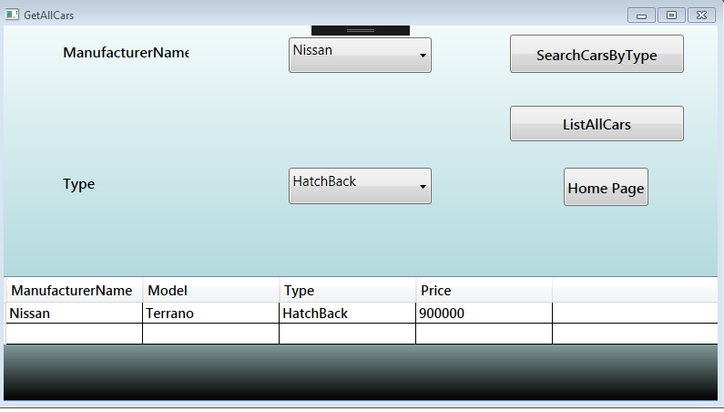
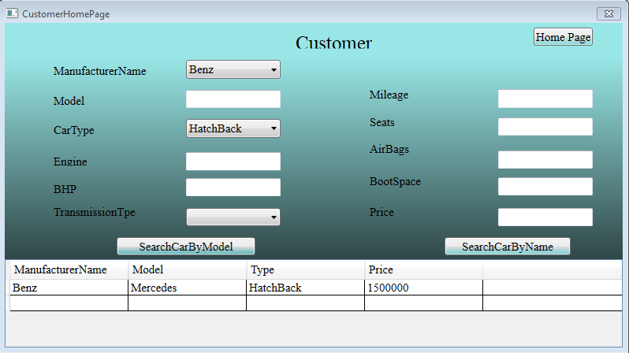
Search Car By Model
Get all Cars
Customer Search Based on Model & Name

Slide 13
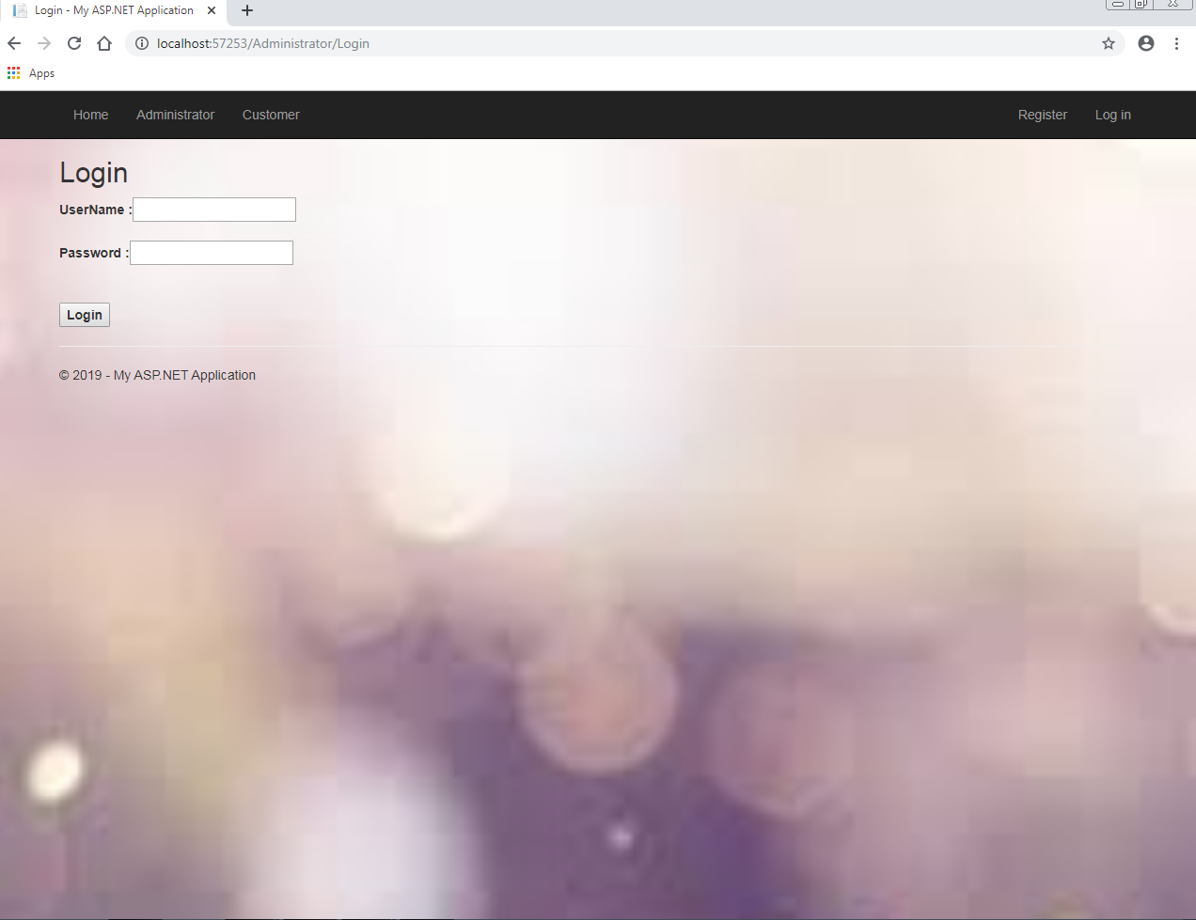

Screenshots-Phase 3
Admin Login
Index Page

Slide 14
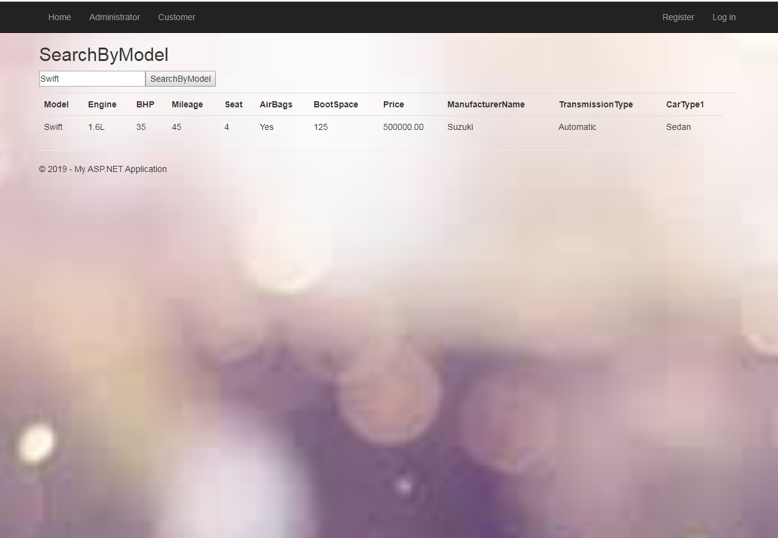
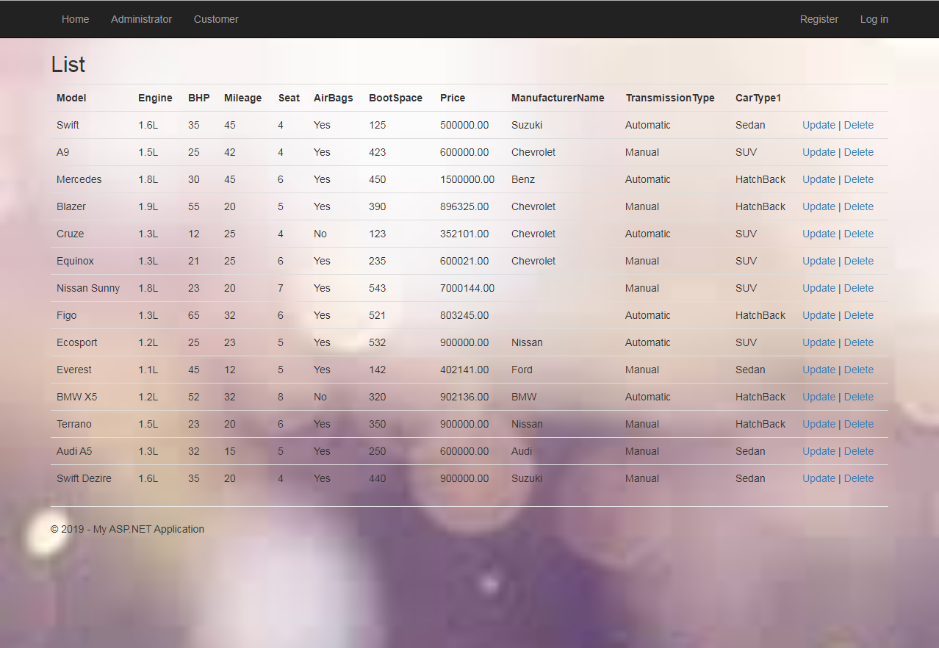
Search Car By Model
Get Car List

Slide 15
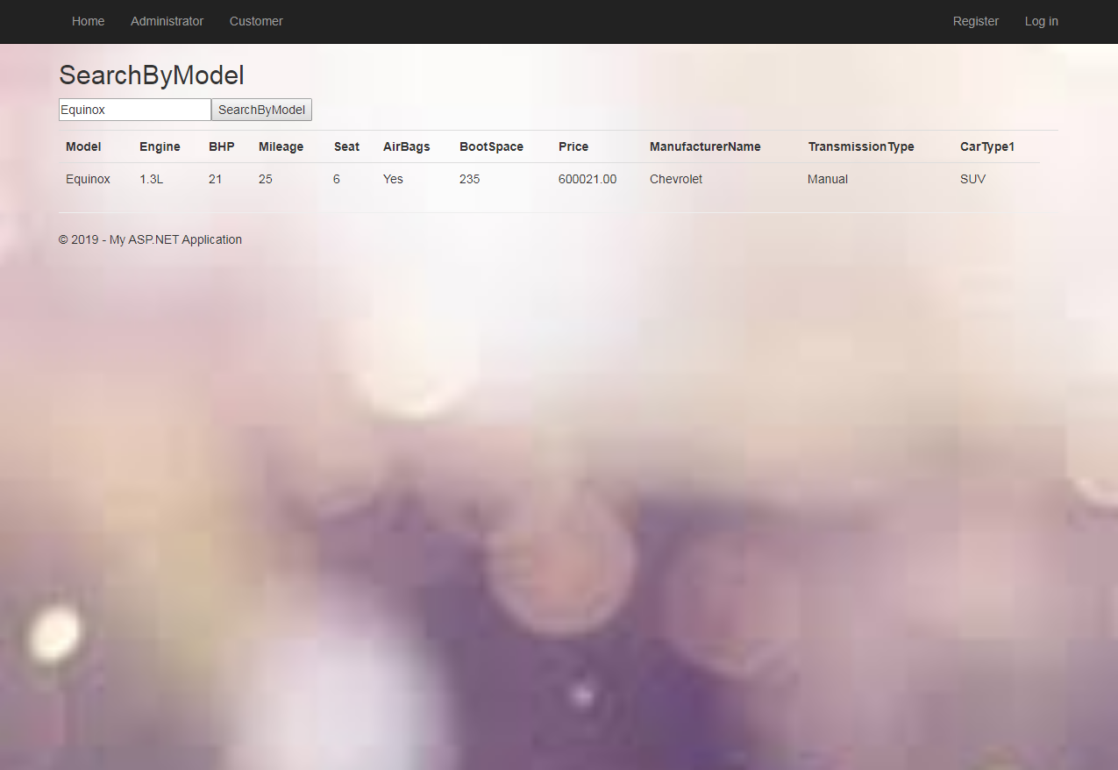
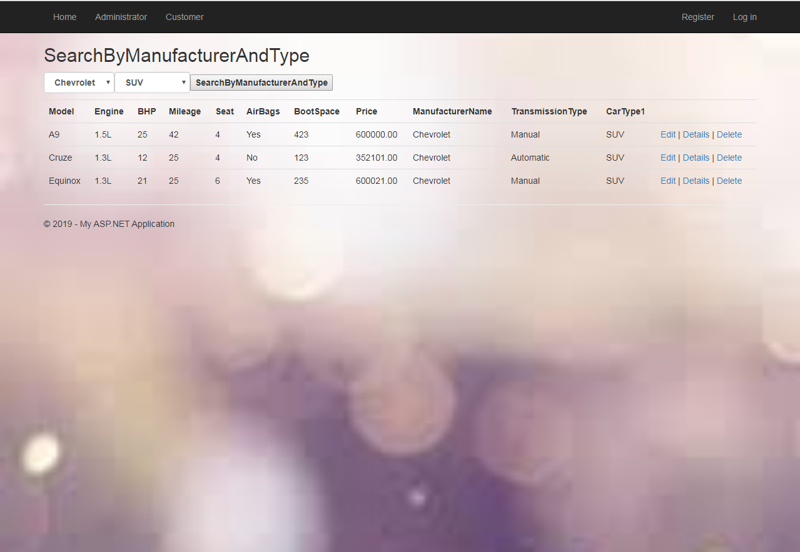
Customer-Search By Model , Name& Type

Slide 16
Future Enhancements
UI can be improved.
Online Booking for cars can be made.

Slide 17


